Slide 1



Department Of Information Science And Engineering
Presents
QUBYTES-2K20
An Online Inter Collegiate Tech Fest
On the 23rd ,24th and 25th September, 2020

Slide 2









Q
U
B
Y
T
E
S
2K20
THE
Q
U
A
N
T
U
M
LEAP TO
THE NEXT
GEN

Slide 3


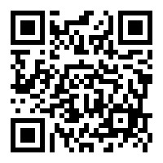
TECHNOWHIZZ
Are you a whizzard ? Do you like solving puzzles? Or are you just so good at guessing the right answers? Then this is just the right event for you! NHCE presents Technowhizz, “The Battle of the Whizzards!” This event aims at portraying what a smarty pant you are! It is the quest to find “The Best Technical Whizzard”!
Let’s get quizzical
General technical quiz, finding the errors and outputs and guessing the domain .
Picture Perfect
Guess the name of the tech genius the company of the CEO/audio
Mind scribble
Using the clues which provide the letter to frame the word
The final battle
Choose the right/wrong fact/facts and Fill in the fact
RULES:
Solo Event
Consists of 4 rounds
Free Registrations
Use of search engines, books, or related resources are not allowed
E-certificates will be provided.
REGISTER HERE!!
EVENT COORDINATOR
Vismaye -9902362984
Sonali - 9986682692

Slide 4



CIPHER-1
Cryptography — the science of secret writing — is an ancient art. Some experts argue that cryptography appeared spontaneously sometime after writing was invented, with applications ranging from diplomatic missives to war-time battle plans. It is no surprise, then, that new forms of cryptography came soon after the widespread development of computer communications.
To satiate the enigma enthusiasts inside you, NHCE presents the ultimate cryptography event that will not only leave your mind working at an insane speed but also get your adrenaline rushing.
RULES:
Solo Event
Consists of 3 rounds
Each round having a duration of 30-45 minutes
Free Registrations
Use of search engines, books, or related resources are not allowed
E-certificates will be provided.
REGISTER HERE!!
EVENT COORDINATORS
Anushka-7086335731
Pooja- 7259702257

Slide 5


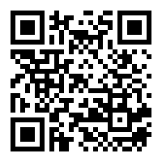
CYBERNATED CONFLICTS
.
When medieval scholars set out to establish the curriculum of the world’s first universities, they considered three liberal arts essential for leadership and promotion of the best ideas: grammar, logic, and rhetoric. Best way to test them, engage in disputations - in other words, debates.
NOTE
RULES
Participants shall register in teams of two, aware that one
participant would go for the topic, and the other would go
against.
The topic of the debate shall be disclosed during the event, with 15 minutes to prepare for it.
Each participant would get speaking time of 90 + 30 seconds.
Participants using any sort of hurtful words/comments shall be disqualified immediately.
The judges’ decision would be the final decision
E-Certificates will be provided
REGISTER HERE!!
EVENT COORDINATOR
Prakriti Sharma-884245952
Pushkar Sinha- 7257930369

Slide 6


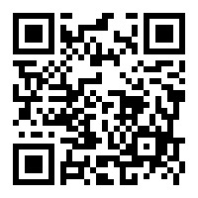
TECH SHARK
Ready to “reap” what boredom made you sow? With Tech Shark, we present to you a change to put all that upskilling to some use. The event consists of two rounds. In Round 1, you will be given a technical product (Visual Studio Code, Chrome, and the kind) and you have to convince and impress The Sharks aka the judges that your product is worth buying. For round 2, it’s the Air Crash! We all have heard of the games or scenarios where there are a lot passengers but limited parachutes. During this round, you will be given a famous tech personality.
RULES
Participants shall register individually.
The product/personality shall be assigned during the event.
Each participant would get speaking time of 2 minutes, for Round 1 and 60 seconds for Round 2.
Participants using any sort of hurtful words/comments shall be disqualified immediately.
The jury’s decision would be the final decision.
REGISTER HERE!!
EVENT COORDINATORS :-
Malvika – 9620817489
kritin– 6363554632

Slide 7



IDEATHON
To overcome increasing brand challenges in this highly competitive industry, NHCE brings to you an IDEATHON to discover real brand solutions. An Ideathon is a short, intensive, brainstorming event to help young talents generate fresh solutions.
Problem statement list will given a day prior to the event where teams has to select 1 problem statement and come up with best and unique solution.
RULES
Team of maximum 3.
The event is of two rounds.
Problem definition and solution should be unique and not copied from any other existing projects.
Power point presentation should follow the format given on the day of event for both the rounds.
Judges decision is final decision.
E-certificates will be provided
REGISTER HERE!!
EVENT COORDINATORS :-
Yashmitha-7259645125
Pinaki- 8982683441

Slide 8

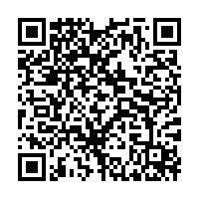
GEEKY PICTIONARY
Ready for some fun????
NHCE has brought to you the experience of having fun while learning technology, also putting your drawing skills to test and letting your friends guess!!
Visual Gateway
Identify images of famous people, companies and taglines !!
Pictionary Scavengers
Random people will be paired in groups of 2. Word will be given to one person,
whowill draw it and the other person has to identify it.
Pick Your Destiny
Identify the hidden logos in the given image!!
Sudden Death
Hangman game based on technical words.
REGISTER HERE!!
RULES
Solo Event
Consists of 4 rounds
Free Registrations
Use of internet is not allowed.
E-certificates will be provided
EVENT COORDINATORS :-
Silpa S – 8197593286
Nidhish – 8105991908

Slide 9

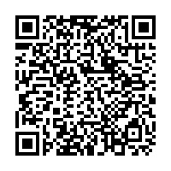
SHUTTER UP
Photography is the art, application and practice of creating durable images by recording light.
Get creative and click pictures to win yourself a prize!!
RULES:
Solo Event
Time limit: 1 hr
No forms of plagarisim will be entertained.
The date and time must be the watermark.
No editing allowed
Free Registrations
E-certificates will be provided.
REGISTER HERE!!
EVENT COORDINATOR
Tanmay T - 8400817704

Slide 10

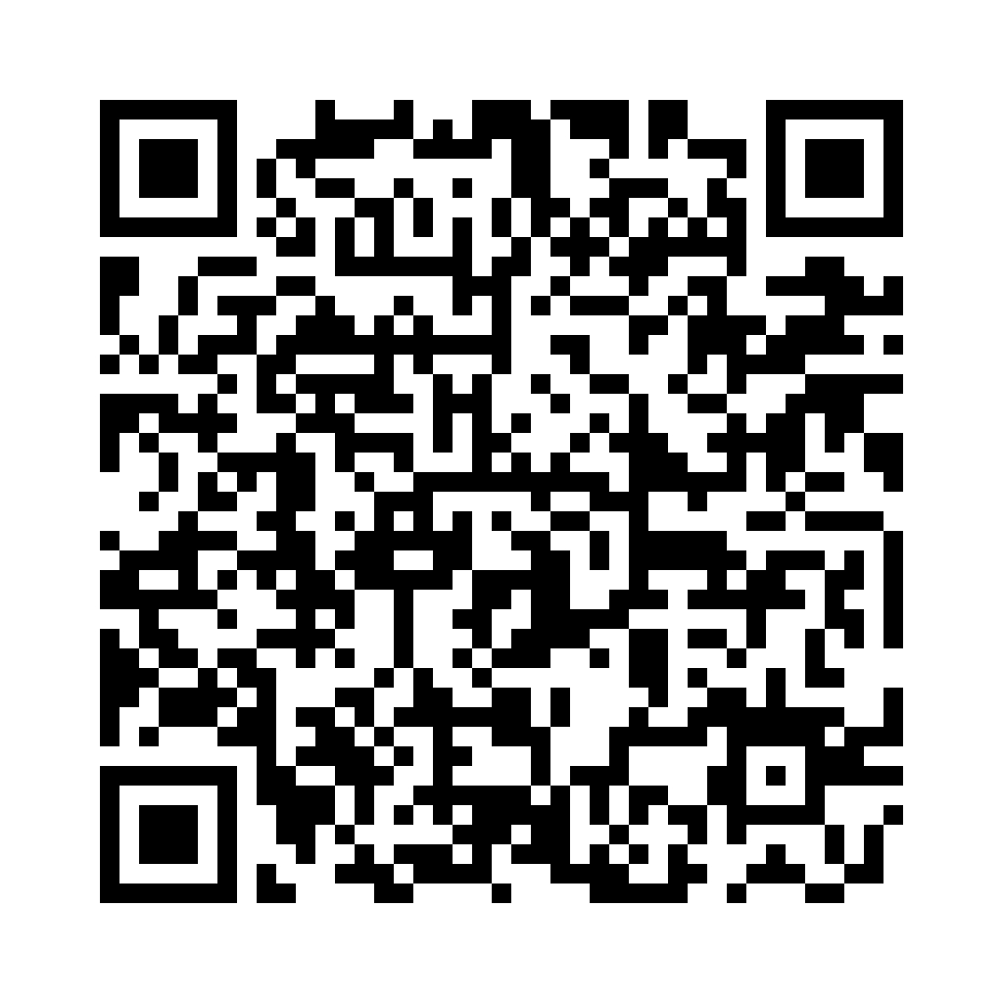
WEB PLAY
Web development skills are in high demand worldwide and well paid too – making development a great career option. It is one of the easiest accessible higher paid fields as you do not need a traditional university degree to become qualified.
Web Play is an event for the Web Developers. The participants will have to develop a webpage based on the theme given to them. They just have to develop the front end using html5, css3,javascript or any other frontend framework.
REGISTER HERE!!
RULES:
Solo event
Duration: 2hrs 30mins
Free Registrations
E-Certificates will be provided
EVENT COORDINATORS :-
Ritom – 9706567265
Srutibant – 8658844192

Slide 11
SCHEDULE
DAY 1: 23rd September, 2020
Web Play 1.00 Pm - 3.30Pm
Cipher-1 3.30 Pm - 6.00Pm
Tech Shark 1.00 Pm – 2.00 Pm
DAY 2: 24th September, 2020
Geeky Pictionary 1.00 Pm - 3.30Pm
Ideathon 3.30 Pm - 6.ooPm
Photography 1.00 Pm – 2.00 Pm
DAY 3 : 25th September, 2020
Technowhizz 1.00 Pm- 3.30 Pm
Cybernated Conflicts 3.30 Pm- 6.00 Pm

Slide 12
QUBYTES TEAM
Event Co-Ordinators
Ritom
Srutibant
Anushka
Pooja
Silpa
Nidhish
Tanmay
Vismaye
Malvika
Krtin
Sonali
Pinaki
Puskar
Prakriti
Yashmita
Graphics
Nidhish
Saurav
Shubhodeep
Vismaye
Pinaki

Slide 13
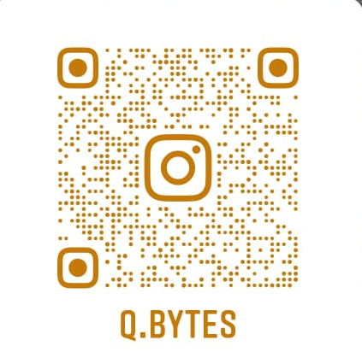

Chief Patron
Student Core Co-Ordinators
Ashwal Srinivas - 78295 03357
Vismaye M - 9902362984
Shubhodep Sarkar - 8002806674
Dr. Mohan Manghnani
Chairman
New Horizon Educational Institution , Bengaluru
Patron
Dr. Manjunatha
Principal
New Horizon College of Engineering, Bengaluru
Convener
Dr. R.J . Anandhi
HOD & Professor
Department of ISE, NHCE
Follow us on Instagram for more updates:
Faculty co-ordinators
Prof.J Karthiyayini Prof.B.Swathi
Dept of ISE Dept of ISE
9731521707 9620681234
Prof.Divya KV Prof .Bilvika KM
Dept of ISE Dept of ISE
9449035154 9008335715
@Q.BYTES

Slide 14
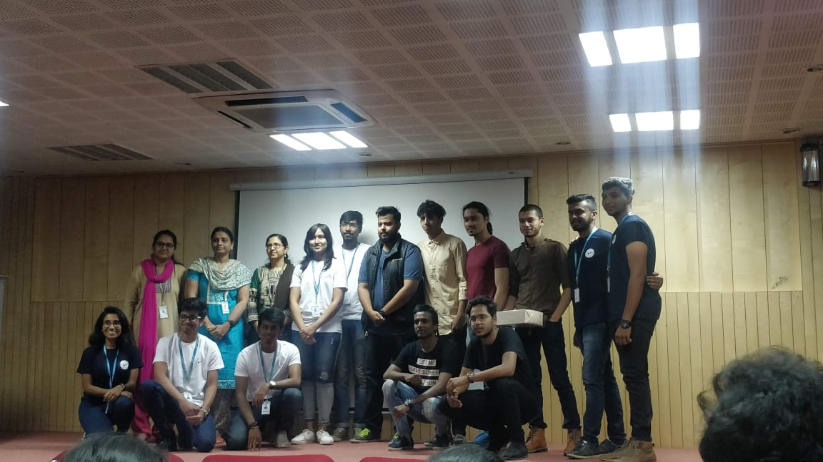
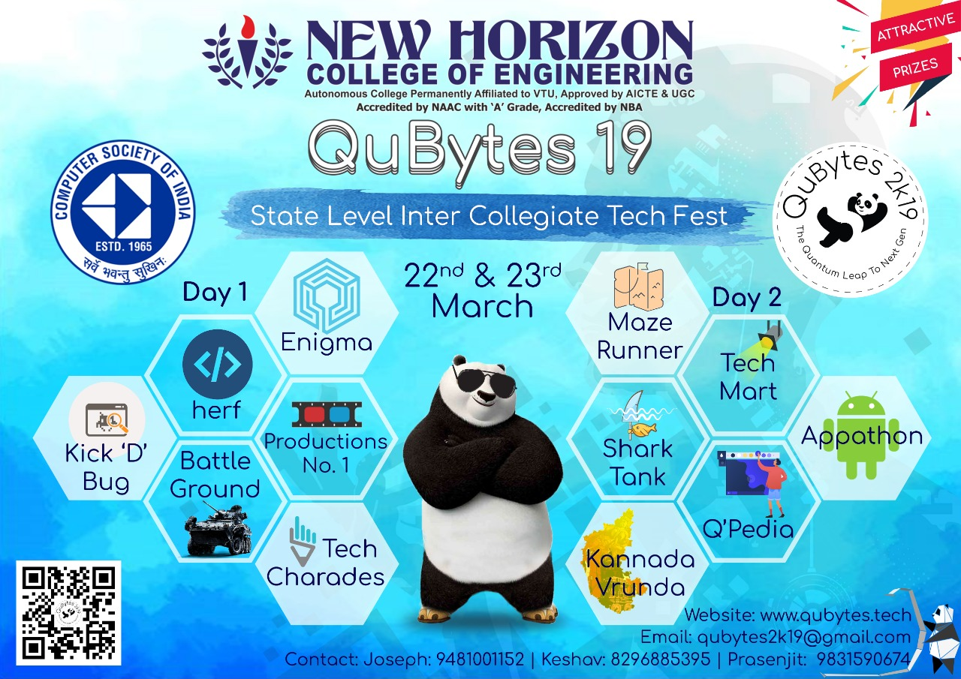
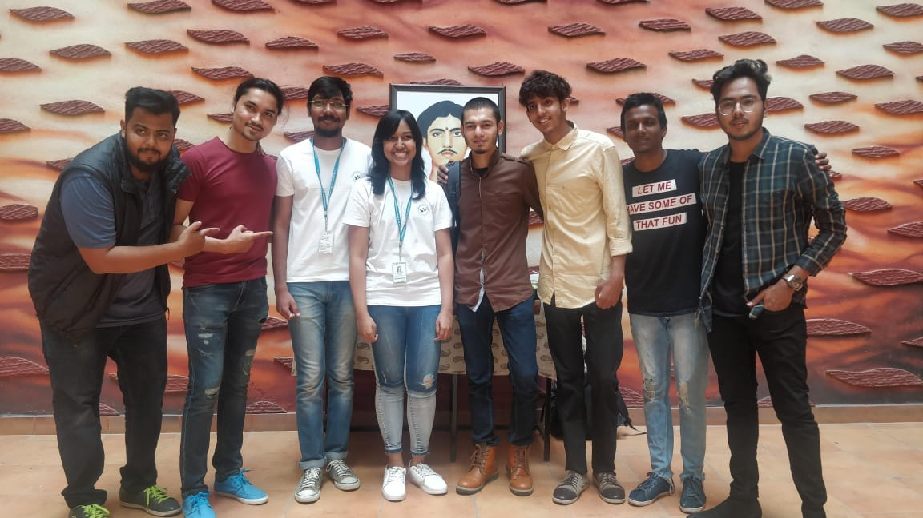
QUBYTES 2K19 GLIMPSES

